Slide 1
ISKEVA: In-SSD Key-Value Database Engine for Video Analytics Applications
LCTES ’22
Author：Yi Zheng、Joshua Fixelle、Nagadastagiri Challapalle、...
Unit: The Pennsylvania State University University Park, USA

Slide 2
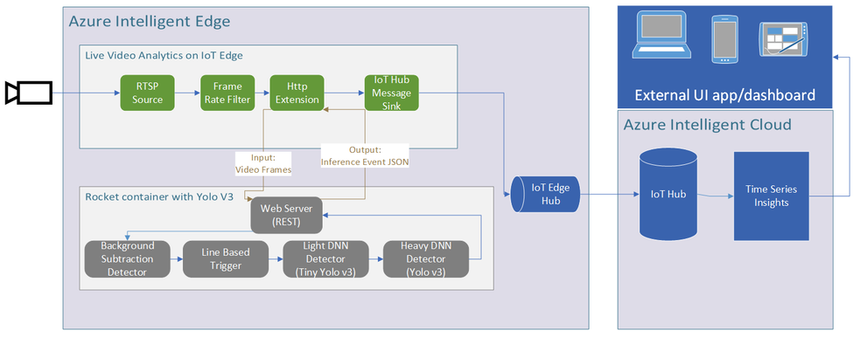
Background
In recent times, key-value databases are being used to store video metadata and video features, extracted using neural networks in commercial video analytic platforms such as Microsoft Rocket.
neural networks are used in both edges and clouds to extract objects in each video frame, and the features of these video frames (pose information, bounding boxes, object classes, etc.) are stored in key-value databases for future use.

Slide 3
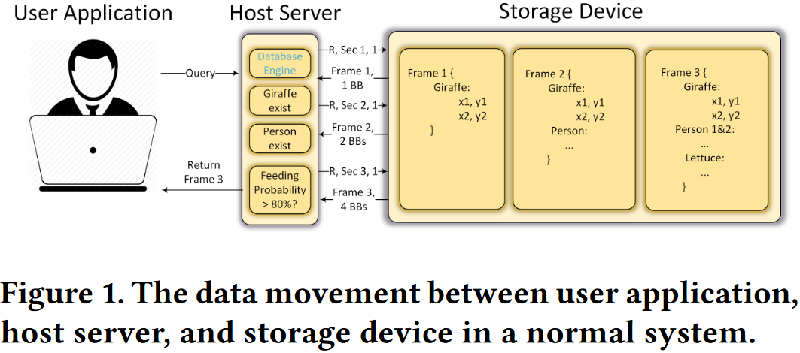
Background
A typical query towards such database could be "find a time slot where guests are feeding giraffes". For such applications, bounding boxes for giraffe, person, and food are pre-extracted and stored in the cloud databases, and the cloud server is responsible for loading these bounding boxes from the storage device and filtering the requested bounding boxes.
Depending on the distribution of features across the video frames, the data movement between the compute server and storage device could be huge.

Slide 4
Problem
In recent years, processing-in-storage compute architectures or systems is gaining prominence as they reduce the data movement between memory/storage and the central processor significantly.
In-SSD compute systems such as INSIDER、NASCENT、DeepStore
Do not readily support the key-value databases for video metadata as they are tailored for specific applications and involve hardware modifications.
Several software-only in-SSD key-value database designs such as Samsung KV-SSD、Crail-KV、KAML
Do not provide data filtering operations and hence cannot reduce the raw data movement (actual user data) between the processor and SSD.
Their access mechanisms are highly optimized for accessing data based on the keys, however, queries to video features can significantly benefit from filtering while scanning the values in the key-value pairs.

Slide 5
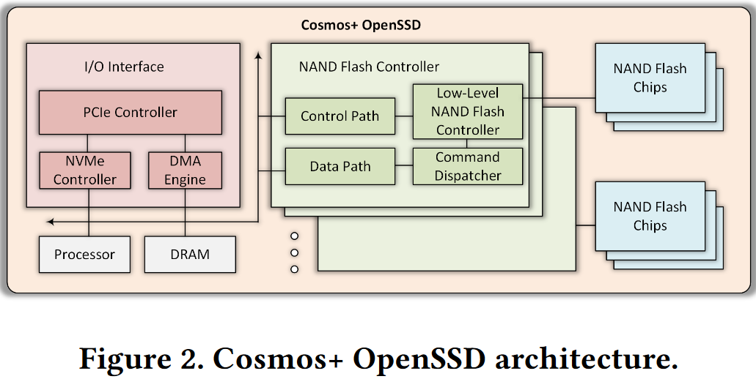
Solution&Design
ISKEVA is a software-only approach, and it provides a key-value like interface similar to existing KV-SSDs and also equipped with a near-SSD feature processing engine implemented in the SSD flash translation layer (FTL) software to support user queries on the data with various predicates etc.
ISKEVA is implemented in the Cosmos+ OpenSSD board.

Slide 6
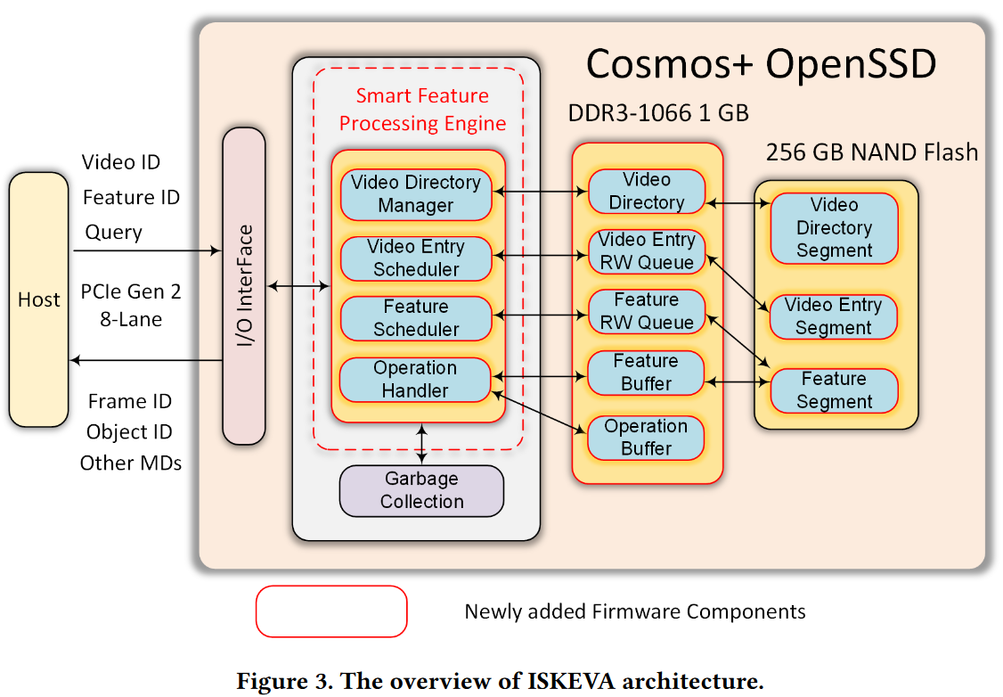
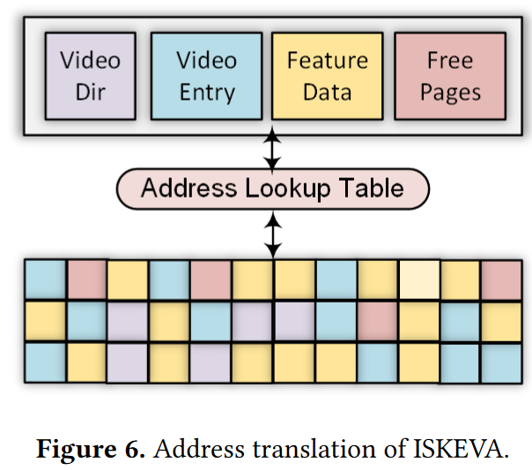
Solution&Design
ISKEVA Overview
ISKEVA augments the conventional FTL running on the embedded CPU core in the SSD with key-value database functionality.
ISKEVA key-value store organizes the video metadata into three levels of hierarchical data structures, video directory, video entry, and feature data.

Slide 7
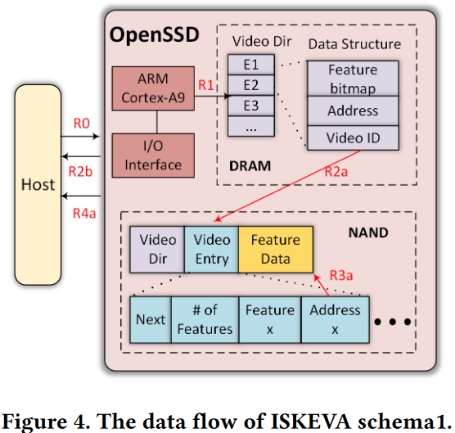
Solution&Design
ISKEVA Data Layout/Organization
ISKEVA organizes the video data consisting of video ID, frame ID, and associated feature/metadata, such as objects in a frame or video, their bounding boxes, etc., into three logical data segments in a hierarchical manner.
Schema1:
Video directory segment:
video ID,
feature bitmap
address to the video entry segment.
Video entries form a linked list for a specific video：
number of features
addresses to flash pages,
next pointer to the node of the video entry linked list.
Feature segment/data：
actual video feature, allocated at page-granularity.
Schema1 is beneficial to filter or retrieve the metadata within a video based on the user input

Slide 8
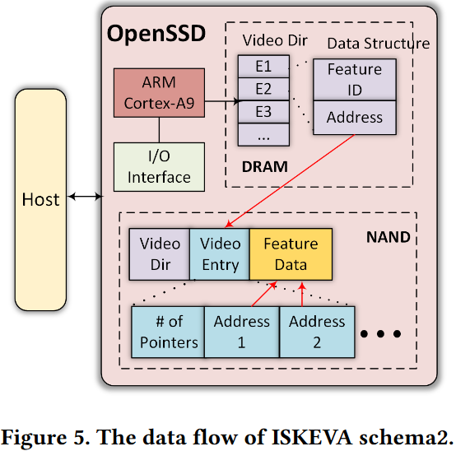
Solution&Design
ISKEVA Data Layout/Organization
ISKEVA organizes the video data consisting of video ID, frame ID, and associated feature/metadata, such as objects in a frame or video, their bounding boxes, etc., into three logical data segments in a hierarchical manner.
Schema2:
Video directory segment:
feature ID
corresponding address to the video entry segment
Video entries：
addresses to all the pages corresponding to a feature.
Feature segment/data：
actual video feature, allocated at page-granularity.
Schema2 is beneficial to filter or retrieve the metadata based on a given feature from the user.

Slide 9
Solution&Design
Video Directory：
The video directory caches entries in the video directory segment into the SSD’s DRAM. It is implemented as a hash table.
Video Entry RW Queue：
The video entry read/write queue is used for buffering access requests to the video entry segment.
Video Feature RW Queue：
The video feature read/write queue is used for buffering access requests to the video feature segment.
Data Buffer:
The data buffer is used to store the feature data returned by the feature scheduler, and feature data that needs to be written to the feature segment in SSD.
Operation Buffer:
The operation buffer stores the user queries from I/O interface. Operation handler picks the requests from this buffer and processes them.
ISKEVA In-DRAM Data Structures

Slide 10
Solution&Design
ISKEVA Software Stack
Video Directory Manager：
reads the video directory from flash in the predefined area and loads on to the DRAM video directory cache. Cache update
Video Entry Scheduler：
The video entry scheduler is responsible for scheduling the reads and writes to the video entry segment as per the requests from video directory manager.
Video Feature Scheduler：
It receives addresses from video entry scheduler and schedules flash accesses to the feature segment, and transfers data pages to the data buffer in the SSD’s DRAM memory.
Operation Handler:
The operation handler is responsible for interacting with the I/O interface of the SSD system, decoding the user query, and applying the predicates on the fetched data from flash storage

Slide 11
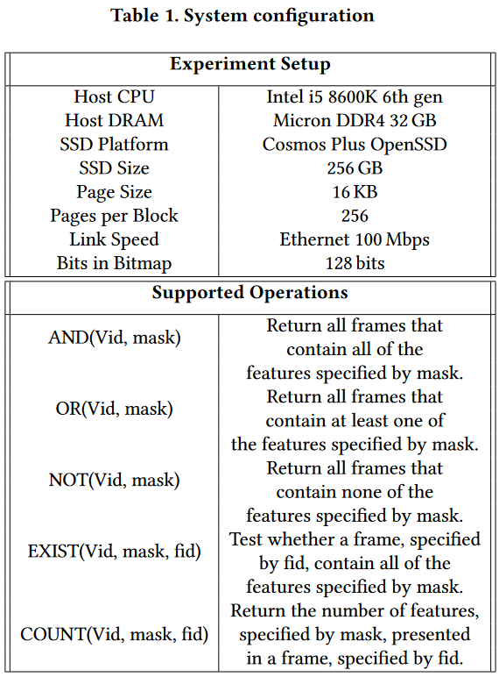
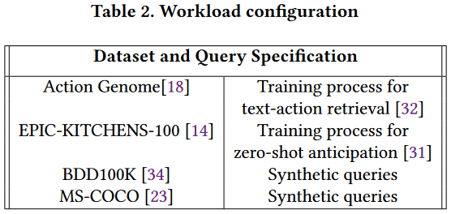
Evaluation
Our design is prototyped on the Cosmos plus OpenSSD board connected with host computer.

Slide 12
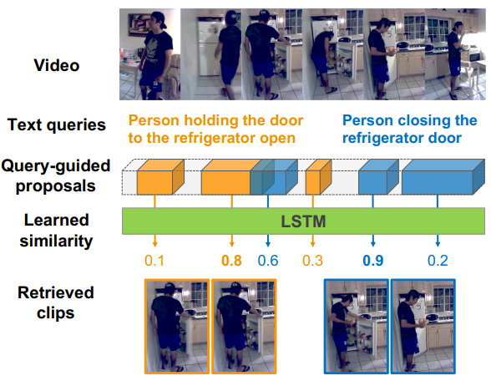
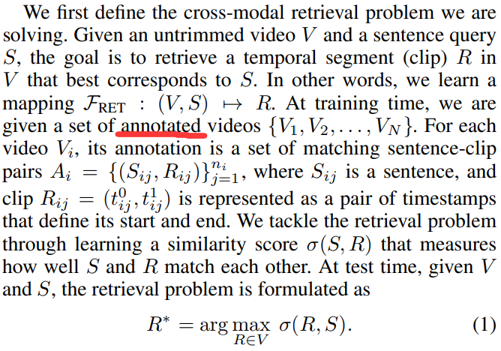
Evaluation
Training process for text-action retrieval
Xu H, He K, Plummer B A, et al. Multilevel language and vision integration for text-to-clip retrieval[C]//Proceedings of the AAAI Conference on Artificial Intelligence. 2019, 33(01): 9062-9069.

Slide 13
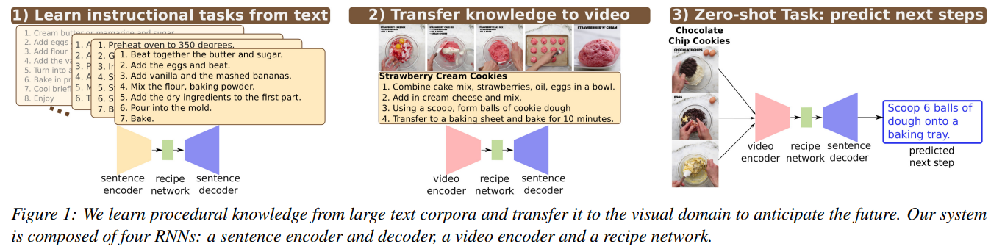
Evaluation
Training process for zero-shot anticipation
Sener F, Yao A. Zero-shot anticipation for instructional activities[C]//Proceedings of the IEEE/CVF International Conference on Computer Vision. 2019: 862-871.

Slide 14
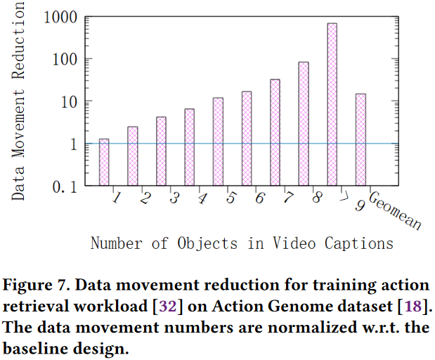
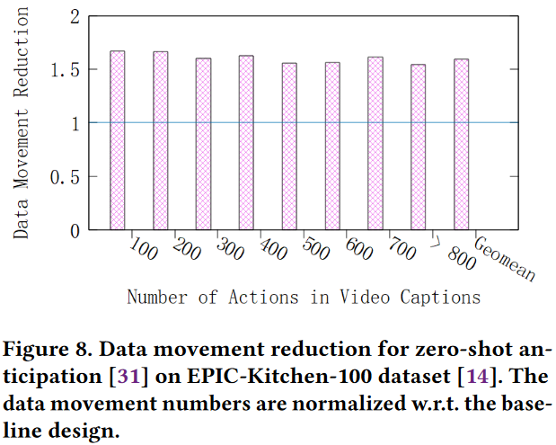
Evaluation
We first evaluated our work based on two real-world research works in computer vision area. Huijuan et al. address the text-based action retrieval problem for videos. Their training step involves reading all frames that matches captions to the host processor.
Fadime and Angela presented Zero-shot anticipation for instructional activities. Their work involves training the model with long cooking videos whose frames are segmented and each segmentation is labeled with a cooking action.

Slide 15
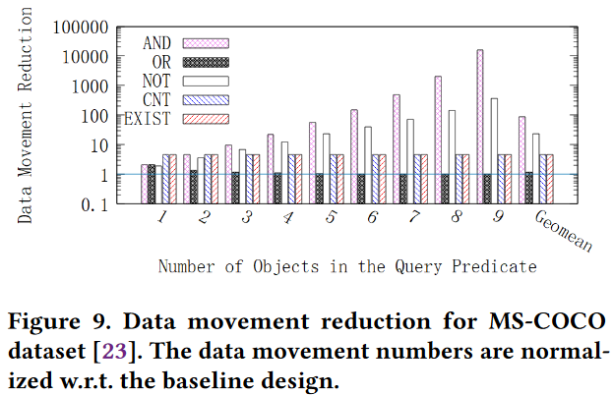
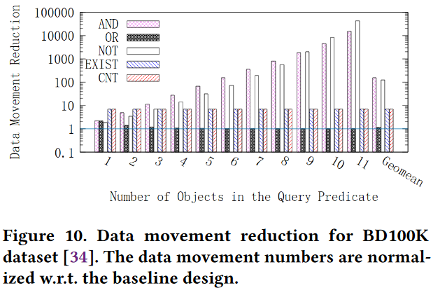
Evaluation
We also analyzed the performance of ISKEVA with synthetic queries on data sets widely used in literature.
We generated the queries with predicates AND, OR, NOT, COUNT (CNT), and EXIST by randomly selecting different number of classes from the dataset. For example, (V, cat, dog, person, couch, beer, AND) retrieves all the frames in the video V which consists of all the five objects.
AND and NOT predicates result in the most data movement reduction because few frame satisfies these predicates.

Slide 16
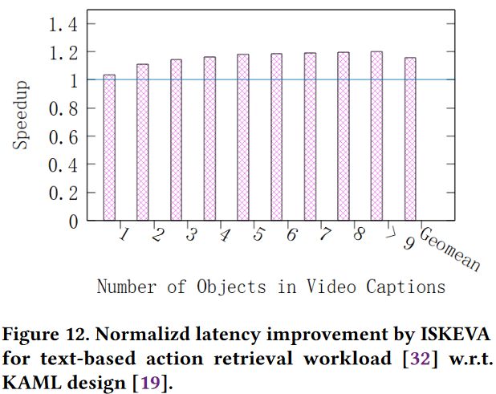
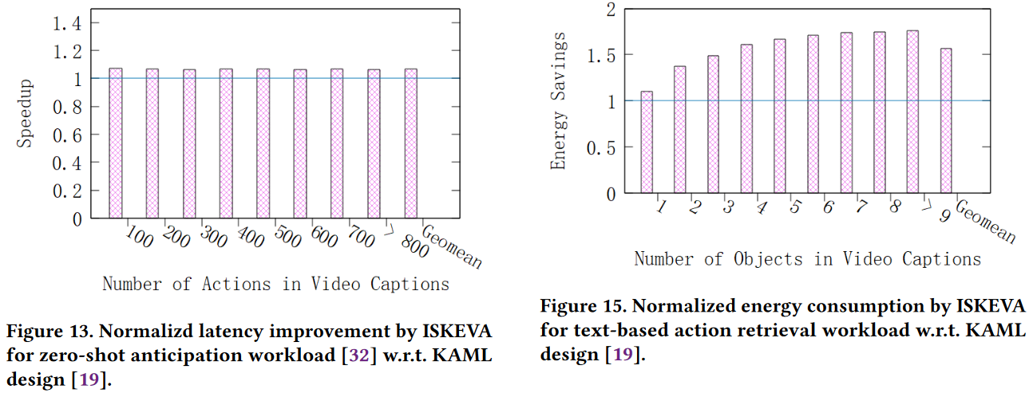
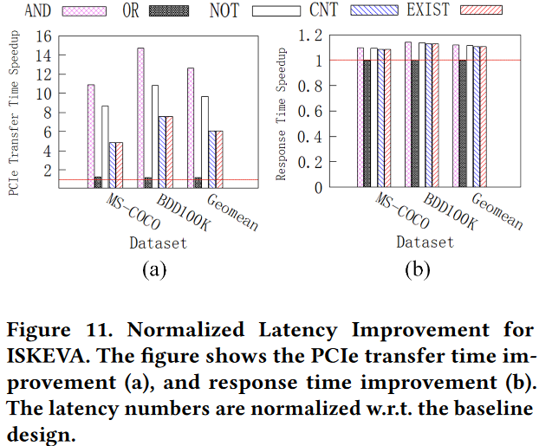
Evaluation
We evaluated end-to-end latency ISKEVA for the two realworld queries and compared with KAML, one of the state-of-the-art KV-SSD designs.

Slide 17
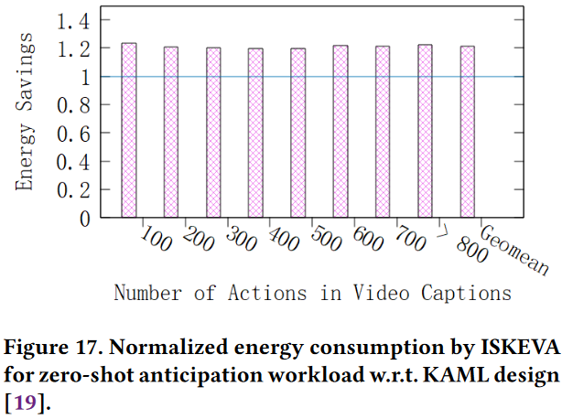
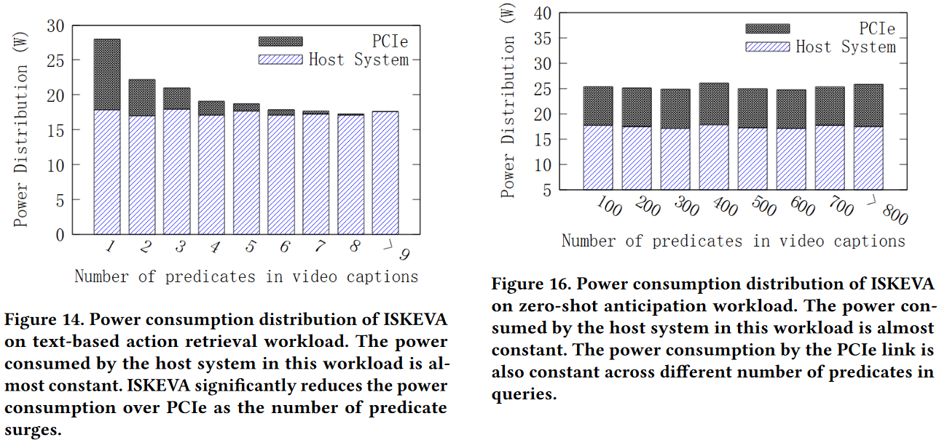
Evaluation
The power consumption of ISKEVA was evaluated with Xilinx Vivado, Xilinx Power Estimator, and RAPL tool.

